Slide 1


VISION-DRIVEN REAL-TIME WALL SURFACE IMPERFECTION DETECTION ON EMBEDDED PLATFORM
1
TEAM MEMBERS
ROHIT SURYA B S – 20BEC1159
JAYANTH R – 20BEC1176
GAUTHAM R – 20BEC1136
GUIDED BY:
Dr. Sheena Christabel Praveen

Slide 2
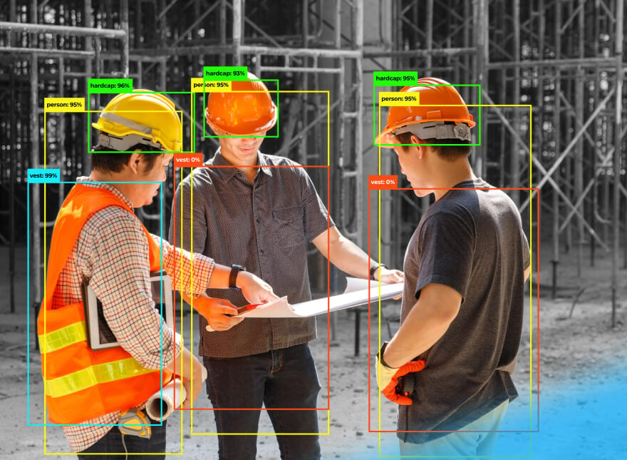
INTRODUCTION
The primary goal of this project is to construct a computer vision model capable of identifying any flaws on a wall, liDAR to gauge the distance between the walls and the system and a voice biometric application has been utilized to prevent unauthorized access.
The system employs a computer vision model to spot any defects on the wall. Additionally, it utilizes liDAR to gauge the distance between itself and the wall and to detect any obstacles in its path.
The system integrates YOSO, a biometric authorization application, ensuring additional security measures, safeguarding the system and the construction site from unauthorized access.
WHAT MOTIVATES THE UNDERTAKING OF THIS PROJECT?

Slide 3
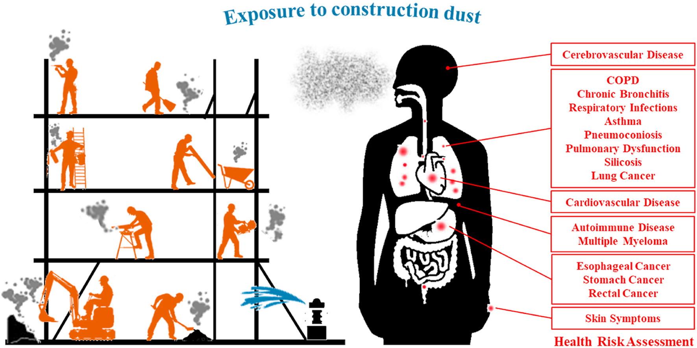
MOTIVATION
Traditional building inspections and tasks are slow and inaccurate. This project uses computer vision and depth sensing to automate the process for faster, more reliable Traditional building inspections and tasks are slow and inaccurate. This project uses computer vision and depth sensing to automate the process for faster, more reliable detection of wall defects, improving safety and building lifespans.
OBJECTIVE:
• To create a janbbd vision model using yolov5 object detection for identifying imperfections on the wall (smooth/rough)
• To develop a voice biometric authentication system that can register a new user, identify and authenticate them.
• To integrate depth sensing with the above computer vision to determine the distance between the walls and the system.
• Attempt to develop a project aligned with Sustainable Development Goal 3, which focuses on promoting good health and well-being. of wall defects, improving safety and building lifespans.
OBJECTIVE:
• To create a computer vision model using yolov5 object detection for identifying imperfections on the wall (smooth/rough)
• To develop a voice biometric authentication system that can register a new user, identify and authenticate them.
• To integrate depth sensing with the above computer vision to determine the distance between the walls and the system.
• Attempt to develop a project aligned with Sustainable Development Goal 3, which focuses on promoting good health and well-being.
Traditional building inspections and tasks are slow and inaccurate. This project uses computer vision and depth sensing to automate the process for faster, more reliable detection of wall defects, improving safety and building lifespans.

Slide 4





PROBLEM STATEMENT
4
Design and develop a comprehensive real-time autonomous system integrating computer vision, voice biometric, and Depth sensing technologies for wall flaw detection, unauthorized access prevention, and distance determination functionalities.

Slide 5
LITERATURE SURVEY
PAPER - 1
PAPER DETAILS | METHODOLOGY | ADVANTAGES | DISADVANTAGES
Title: The Pascal Visual Object Classes Challenge: A Retrospective Author: Mark Everingham et al Type: Journal Name of the Journal: International Journal of Computer Vision YoP: 2014 | The Pascal Visual Object Classes (VOC) Challenge functioned as a benchmark for object recognition and detection in computer vision. It offered a publicly available dataset with labelled images and standardized evaluation tools. Every year, researchers participated in a competition where they applied their algorithms to this dataset. By analyzing the strengths and weaknesses of these competing methods, the challenge provided valuable insights into the progress and limitations of computer vision techniques. | Tracks progress in computer vision Highlights strengths and weaknesses of approaches Provides valuable insights for future research | Focuses on VOC challenge Limited evaluation metrics Doesn’t delve into specific algorithms

Slide 6
LITERATURE SURVEY
PAPER - 2
PAPER DETAILS | METHODOLOGY | ADVANTAGES | DISADVANTAGES
Title: Faster R-CNN: Towards Real-Time Object Detection with Region Proposal Networks Author: Shaoqing Ren et al Type: Journal Name of the Journal: IEEE Transactions on Pattern Analysis and Machine Intelligence YoP : 2017 | Faster R-CNN addresses object detection in two steps. First, a newly introduced Region Proposal Network (RPN) scans the image using convolutional layers to pinpoint likely object locations. This RPN shares these layers with the second stage, a Fast R-CNN detector. The detector takes the RPN's suggestions and refines them, predicting the class of each object and its precise bounding box. This two-stage approach, combined with shared convolutional features, allows Faster R-CNN to achieve faster object detection with good accuracy. | Faster object detection: By introducing the RPN, Faster R-CNN significantly improves detection speed. Maintained accuracy: Faster R-CNN achieves high accuracy in object detection tasks. Shared convolutional features: Sharing convolutional features between the RPN and Fast R-CNN detector improves efficiency by reducing computational cost. | Computational complexity: Faster R-CNN can be computationally expensive due to its two-stage architecture. Potential for correlated samples: Training can be slower due to all RPN anchors within a mini-batch being extracted from the same image, leading to correlated features. Limited to general object detection: Faster R-CNN might not handle specific challenges like object segmentation or pose estimation.

Slide 7
LITERATURE SURVEY
PAPER - 3
PAPER DETAILS | METHODOLOGY | ADVANTAGES | DISADVANTAGES
Title: One Voice is All You Need: A One-Shot Approach to Recognize Your Voice Author: Priata Nowshin Type: Conference Name of the Conference: 2022 7th International Conference on Data Science and Machine Learning Applications (CDMA) YoP: 2022 | The paper proposes a method for speaker recognition using a one-shot learning approach with a Siamese neural network architecture. One-shot learning allows the model to be trained on a single sample per speaker. The Siamese network compares two audio inputs to determine how similar they are. The model is trained using a triplet loss function, which ensures that the distance between similar speakers in the embedding space is smaller than the distance between dissimilar speakers. | Reduced Training Data: Requires only one voice sample per speaker for training, making it efficient for scenarios with limited data. Simplicity: One-shot learning approach simplifies the training process compared to traditional methods. Security Potential: Could be useful for speaker identification in security applications. | Limited Testing: The paper might not discuss extensive testing on various datasets or noise conditions. Accuracy Needs Evaluation: The one-shot approach might lead to lower accuracy compared to traditional methods with more training data. Novelty Relies on Further Research: While the concept is interesting, further research is needed to confirm its effectiveness in real-world applications.

Slide 8
LITERATURE SURVEY
PAPER - 4
JOURNAL DETAILS | METHODOLOGY | ADVANTAGES | DISADVANTAGES
Title: Crack detection in building walls based on geometric and radiometric point cloud information​ Authors: P Stałowska ​ Type: Journal Name of the Journal: Automation in Construction​ YoP: 2022 | The paper proposes a crack detection method for building walls. They use a 3D laser scanner to capture the wall's surface as a point cloud. Features like roughness and intensity variations are extracted from this data to identify potential cracks. A machine learning algorithm, trained on labeled crack data, then classifies points in the point cloud as crack or non-crack. This approach automates crack detection using both geometric and radiometric information. ​ | Automation: The method automates crack detection, reducing reliance on manual inspection and improving efficiency. Data-driven: Utilizes rich data from 3D laser scanners to capture both geometric and radiometric properties of cracks. Detailed analysis: Extracts multiple features for better crack identification compared to relying on a single feature.​ | Machine learning dependence: Relies on a well-trained machine learning algorithm, requiring labeled data for training. Scanner limitations: Accuracy might be affected by scanner resolution and environmental conditions during data acquisition. Potential for misclassification: Machine learning algorithms can make mistakes, so some cracks might be missed or misidentified.

Slide 9
LITERATURE SURVEY
PAPER - 5
JOURNAL DETAILS | METHODOLOGY | ADVANTAGES | DISADVANTAGES
Title: Voice biometric: A technology for voice based authentication ​ Authors: N Singh, A Agrawal, RA Khan ​ Type: Conference Name of the Conference: Advanced Science, Engineering and Medicine ​ YoP: 2018 | The paper investigates Speaker recognition technology, its uses and future applications. Speaker recognition systems work by extracting features from a person's voice, such as pitch, timbre, and speaking style. These features are then compared to a database of voice prints in order to identify the speaker. Speaker recognition systems can be used for a variety of applications, such as security access control, voice-based banking, etc. The performance of the system is measured by factors such as false acceptance rate (FAR), false rejection rate (FRR), and equal error rate (EER). | Security and access control Convenient and hands-free Can be used for identification and verification | Can be fooled by recordings Performance can be affected by noise Privacy concerns about voice data collection

Slide 10
LITERATURE SURVEY
PAPER - 6
JOURNAL DETAILS | METHODOLOGY | ADVANTAGES | DISADVANTAGES
Title: Vision-based defects detection for bridges using transfer learning and convolutional neural networks Authors: Jinsong Zhua , Chi Zhanga , Haidong Qib and Ziyue Lua Type: Journal Name of the Journal: Structure and Infrastructure Engineering YoP: 2019 | Defect images are pre-processed using image processing techniques (IPTs). A transfer learning model is trained on 1180 images with diverse sizes and resolutions. The trained model is tested on 134 images from different bridges. Comparative studies compare the proposed approach to classical MLAs and traditional hand-crafted feature extraction methods. | Achieving 97.8% accuracy demonstrates efficacy. Leverages pre-trained models (SVM), reducing data and resource requirements. Accommodates varied image sizes and resolutions. Preprocessing enhances model robustness by standardizing data. | May struggle with unseen defect types or conditions. Performance may suffer with low-quality images.

Slide 11
LITERATURE SURVEY
PAPER - 7
JOURNAL DETAILS | METHODOLOGY | ADVANTAGES | DISADVANTAGES
Title: Deep Learning for Detecting Building Defects Using Convolutional Neural Networks​ ​ Authors: Husein Perez, Joseph H. M. Tah and Amir Mosavi​ ​ Type: Journal​ Name of the Journal: Sensor Networks ​ YoP: 2019 | The project leveraged transfer learning from a pre-trained VGG-16 model on a dataset of 2,622 images (augmented for robustness) to classify and localize defects (mould, stain, deterioration) in buildings, achieving high accuracy (87.50% testing). For future use, a dataset with visible defects and larger labeled images are required for broader applications.​ | High accuracy (97.83% training, 98.86% validation, 87.50% testing).​ Can detect and classify multiple defect types (mould, stain, deterioration).​ Can localize defects with CAM.​ Works with relatively small datasets.​ | Limited to visible defects.​ Not robust to extreme lighting or orientation.​ Only considers one defect type per image.​ Requires large labelled datasets for training.​

Slide 12
LITERATURE SURVEY
PAPER - 8
JOURNAL DETAILS | METHODOLOGY | ADVANTAGES | DISADVANTAGES
Title: Image Processing-Based Recognition of Wall Defects Using Machine Learning Approaches and Steerable Filters​ ​ Author: Nhat-Duc Hoang​ ​ Type: Journal​ Name of the Journal: Computational Intelligence and Neuroscience ​ YoP: 2018 | This project investigates automated wall defect detection using image processing and machine learning. It extracts features from wall images via steerable filters and projection integrals, then trains multiple classifiers (SVMs and LSSVMs) to categorize cracks, spalling, and intact areas. The LSSVM model shines with 85.13% accuracy, surpassing conventional methods like neural networks and offering potential for efficient building inspections, though further refinement is needed to address limitations. | Automated defect detection, reducing time and cost of manual inspections.​ High accuracy, with LSSVM achieving 85.13% overall classification accuracy.​ More accurate than other methods like neural networks, classification trees, etc.​ Potential to improve efficiency and effectiveness of building inspections. | Requires labelled training data Not perfect, can make false positive/negative errors Limited to similar wall structures for testing May not be suitable for complex textures or backgrounds

Slide 13
LITERATURE SURVEY
PAPER - 9
JOURNAL DETAILS | METHODOLOGY | ADVANTAGES | DISADVANTAGES
Title: Automatic Defect Recognition in X-Ray Testing Using Computer Vision Authors: Domingo Mery, Carlos Arteta Type: Conference Name of the Conference: 2017 IEEE Winter Conference on Applications of Computer Vision YoP: 2017 | The authors investigated automated defect detection in X-ray testing using a dataset of 47,520 cropped X-ray images (32x32 pixels) with labels (defects or no-defects). They evaluated 24 computer vision techniques, including deep learning, sparse representations, and texture features. The LBP descriptor with SVM-linear classifier achieved the best performance (95.2% accuracy). | Achieved 95.2% accuracy with LBP descriptor + SVM classifier. Outperformed deep learning models pre-trained on ImageNet. Trained CNN model on X-ray images achieved 85% accuracy. Applicable to other defect detection tasks with large image datasets. | Deep learning models pre-trained on ImageNet performed poorly. Fine-tuning large CNN models on X-ray dataset led to overfitting. Sliding-window strategy for whole X-ray images needs improvement. Requires large dataset of representative images for different defect types.

Slide 14
LITERATURE SURVEY
PAPER - 10
JOURNAL DETAILS | METHODOLOGY | ADVANTAGES | DISADVANTAGES
Title: Real time speaker recognition system using MFCC and vector quantization technique Authors: R Bharti, P Bansal Type: Jounal Name of the Journal: International Journal of Computer Applications YoP: 2015 | The paper describe about Mel-frequency method which is commonly used in speech recognition systems. The MFCC technique converts a speech signal into MFCCs which represent the speech characteristics. This involves dividing the signal into chunks, applying windows, and transforming them to the frequency domain.. Finally, it extracts MFCCs to capture the essential spectral features. These features are then used for speaker recognition by comparing them to pre-built speaker models using a codebook generated by the LBG algorithm. | Matches human hearing: Emphasizes lower frequencies like humans do. Robust to noise: Less sensitive to background noise compared to raw frequency analysis. Computationally efficient: Feature extraction is relatively fast and requires less processing power. Effective representation: Captures speaker characteristics well-suited for recognition. | Sensitive to severe noise: May not perform well in very noisy environments. Lossy compression: Transformation process discards some spectral information. Not perfect speaker identification: Can be fooled by very similar voices. Limited to short durations: Works best for short speech segments.

Slide 15
LITERATURE SURVEY
PAPER - 11
JOURNAL DETAILS | METHODOLOGY | ADVANTAGES | DISADVANTAGES
Title: Voice based automatic person identification system using vector quantization Authors: AAM Abushariah, TS Gunawan, J Chebil, MAM Abushariah Type: Conference Name of the Conference: 2012 International Conference on Computer and Communication Engineering (ICCCE) YoP: 2012 | The methodology for this voice-based person identification system involved two main stages: feature extraction and classification. First MFCC were used to extract a set of characteristic factors from the voice recordings. MFCCs convert the speech waveform into a data format that highlights the speaker-specific qualities of the voice. Then, a technique called Vector Quantization was employed for training and classification. VQ essentially creates a codebook of representative voice features and assigns new voices to the closest match in the codebook, effectively identifying the speaker. | Relatively simple to implement using toolboxes like MATLAB Effective in extracting features from voice signals using MFCC Achieves good recognition rates (average of 92.6% in this study) | Performance can be affected by factors like background noise and speaker variability Limited scalability for very large datasets Vector Quantization (VQ) might not be the most advanced classification technique available

Slide 16
LITERATURE SURVEY
PAPER - 12
JOURNAL DETAILS | METHODOLOGY | ADVANTAGES | DISADVANTAGES
Title: Biometric voice recognition in security system Authors: HNM Shah, MZ Ab Rashid, MF Abdollah, MN Kamarudin, KL Chow, Z Kamis Type: Journal Name of the Journal: Indian Journal of Science and Technology YoP: 2014 | The paper explores a voice recognition system for administrator authentication. It records a single password spoken by the administrator, converts it to a unique voice signature using MFCC, and stores this signature for reference. During access, the administrator repeats the password. The system compares the new voice signature with the stored one and grants or denies access based on their similarity. This approach successfully identified the administrator's voice in simulations but offers medium-level security. | Simple and Easy to Implement: The system uses MFCC, a well-established technique, and requires only a single password for enrollment. Can distinguish between administrator and imposters: The experiment with 10 people showed successful recognition of the administrator's voice and rejection of others. Potential for embedded systems: The paper suggests the possibility of using this method in access control devices. | Limited Accuracy (75%): The experiment repeating the administrator's voice recognition resulted in a 25% failure rate. Vulnerable to voice variations: The system struggles with variations in speech volume due to energy depth variability. Not ideal for high-security applications: The acknowledged medium-level security suggests limitations for critical systems. Doesn't account for diverse speakers: The experiment only tested with a single administrator and didn't consider different genders or ages. Susceptible to background noise

Slide 17
RESEARCH GAP
High initial costs.
Partial automation.
Limited to similar wall structures, may not be suitable for complex textures or background.
May struggle with unseen defect types or conditions, performance may struggle with low image quality.
Susceptible to background noise.
Vulnerable to voice variations
Can be fooled by voice recordings

Slide 18
PROPOSED SOLUTIONS
The proposed solution entails developing a real-time, autonomous computer vision equipped with voice biometric authentication system capabilities to identify imperfections on walls.
By integrating liDAR, the system determines the precise depth of imperfection on the wall
Voice biometrics offers a security solution for automated inspections by analyzing a user's unique vocal characteristics. This allows for verification of the inspector's identity, reducing the risk of unauthorized access.

Slide 19
OBJECTIVE
To create a computer vision model using yolov5 object detection for identifying imperfections on the wall (smooth/rough)
To develop a voice biometric authentication system that can register a new user, identify and authenticate them.
To integrate depth sensing with the above computer vision to determine the distance between the walls and the system.
Attempt to develop a project aligned with Sustainable Development Goal 3, which focuses on promoting good health and well-being.

Slide 20
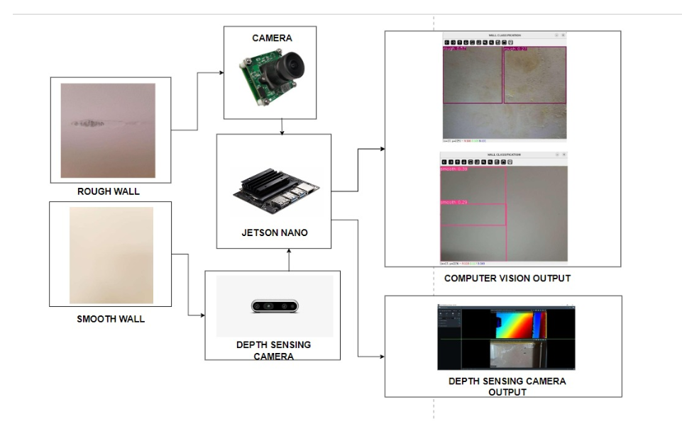
OVERALL ARCHITECTURE

Slide 21
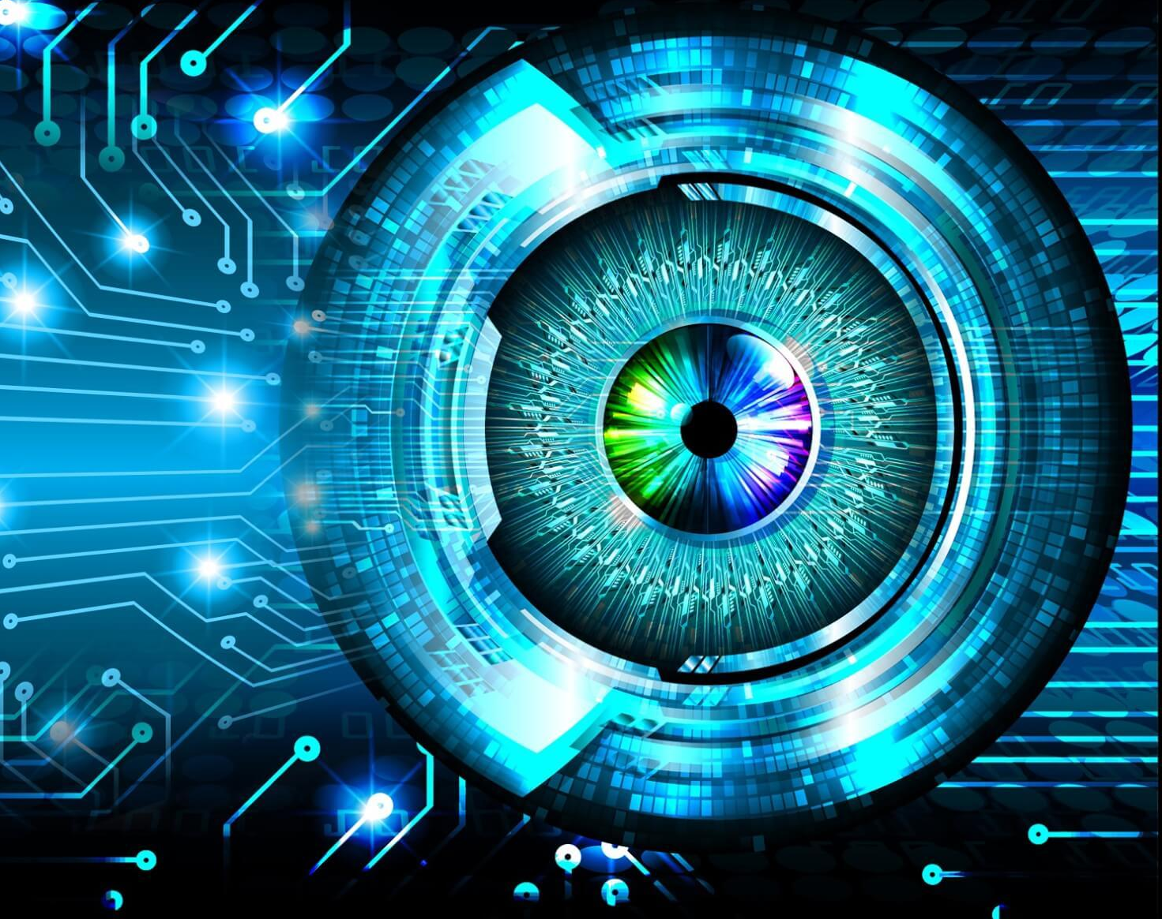
COMPUTER VISION
This Photo by Unknown author is licensed under CC BY-NC.

Slide 22
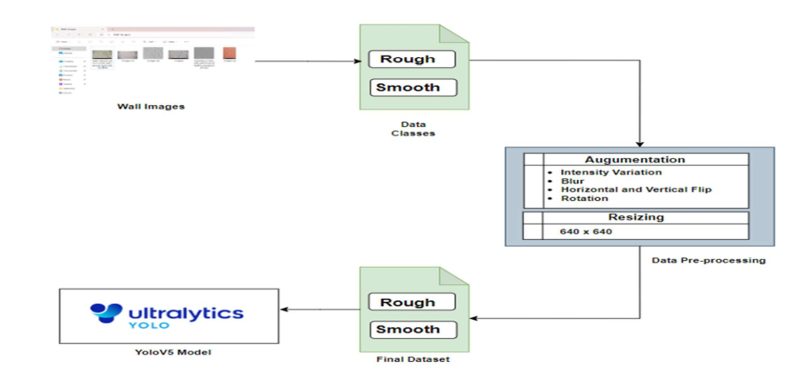
IMPLEMENTATION OF COMPUTER VISION MODEL
22

Slide 23
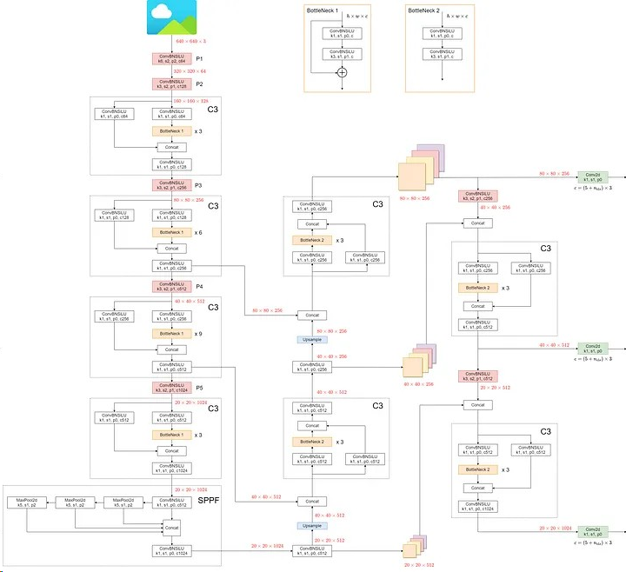
ARCHITECTURE OF YOLOV5
23

Slide 24
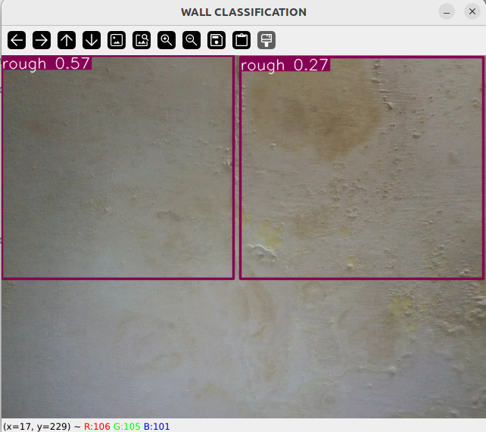
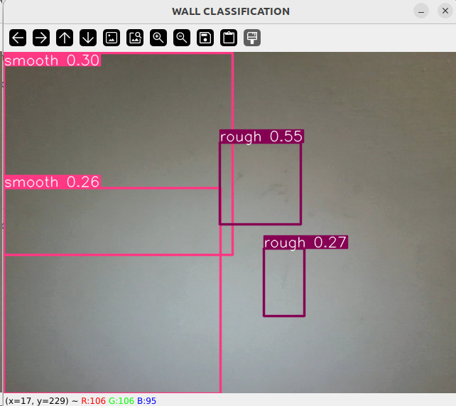
RESULTS
24
We built a system to automatically find imperfections on walls in real-time using computer vision. To achieve this, we trained our object detection model based on ultralytic’s YOLOv5 object detection model. We collected a dataset of 1,296 wall images, drew bounding boxes and created two classes: smooth and rough using a python based annotating tool called labelimg. the model was trained for 500 epochs, but we found that it reached its peak performance at the 334th epoch, achieving optimal accuracy and precision in identifying smooth and rough walls in real time.

Slide 25
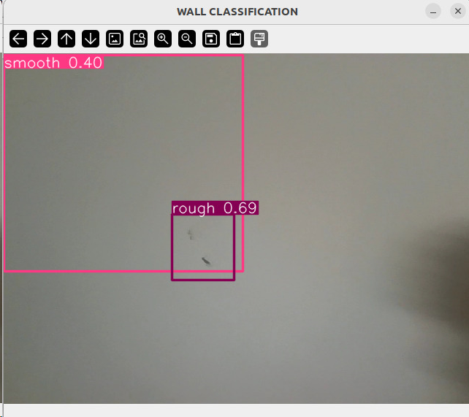
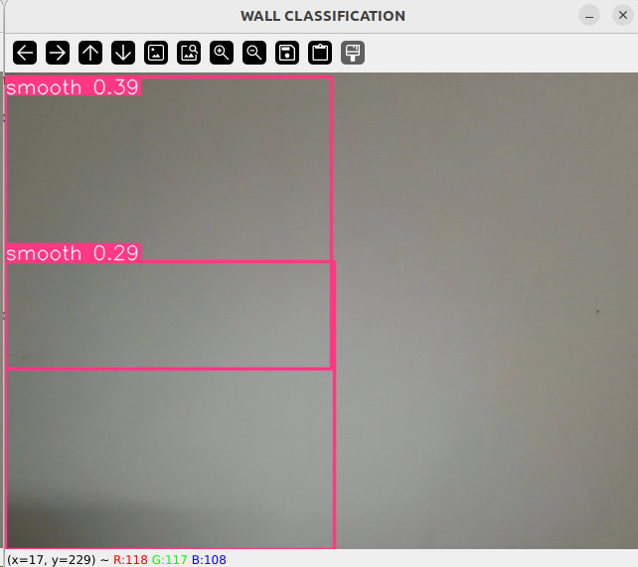
RESULTS
25

Slide 26

VOICE BIOMETRIC SYSTEM
This Photo by Unknown author is licensed under CC BY-SA-NC.

Slide 27
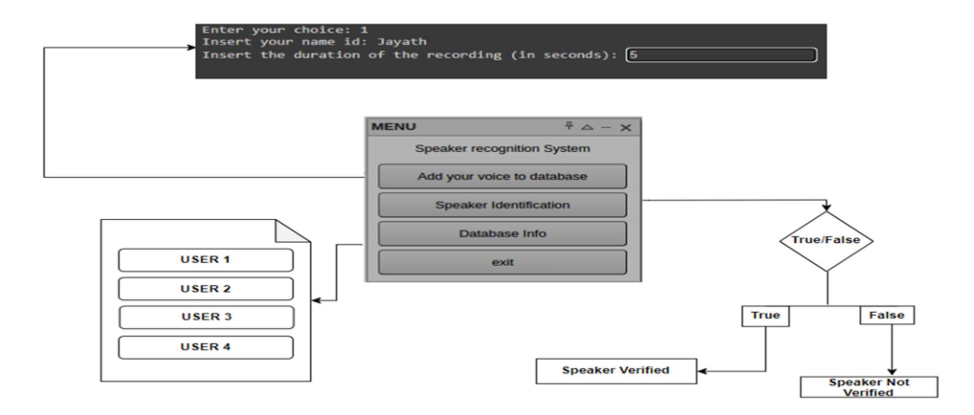
ARCHITECTURE

Slide 28
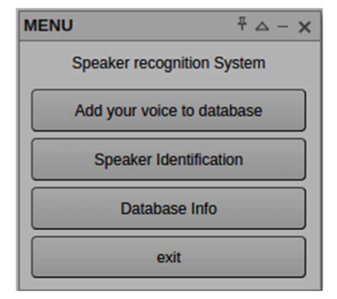
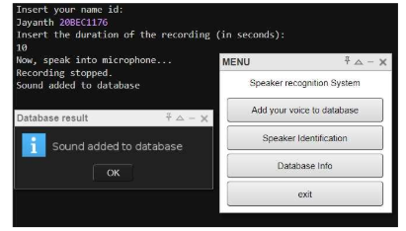
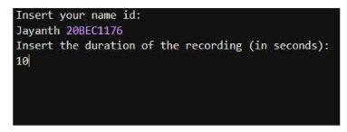
RESULTS
28

Slide 29
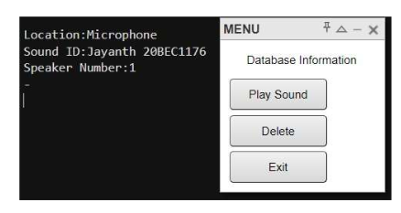
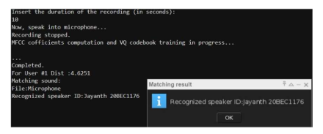
RESULTS
29

Slide 30
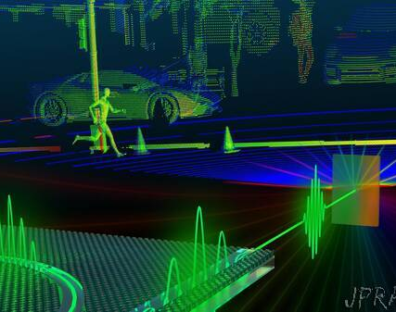
Depth Sensing
Depth sensing is used to calculate the depth variations within a wall surface
The intensity of the colour shows that the damage on the wall is more and wise versa
Red represents deeper sections where the wall is damaged to a large extent and blue region represents the smooth surface Using a colour coded system, we can project the wall to the user with accurate map of depth variations
This Photo by Unknown author is licensed under CC BY-NC-ND.

Slide 31
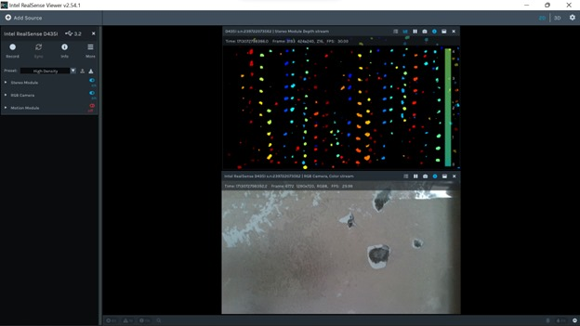
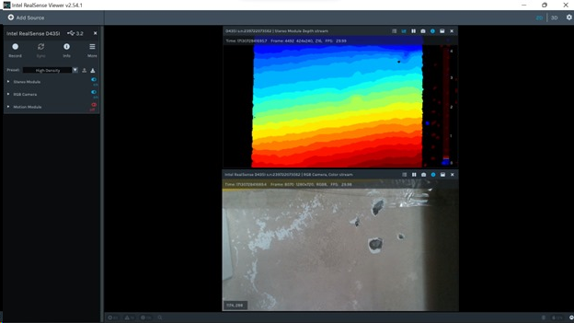
RESULTS

Slide 32
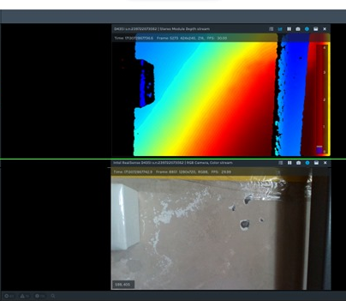
RESULTS

Slide 33

REFERENCES
Everingham, M., Van Gool, L., Williams, C. K. I., Winn, J., & Zisserman, A. (2010). The PASCAL Visual Object Classes (VOC) Challenge: A Retrospective. International Journal of Computer Vision, 111(1), 98–136.
Ren, S., He, K., Girshick, R., & Sun, J. (2015). Faster R-CNN: Towards Real-Time Object Detection with Region Proposal Networks. In Advances in Neural Information Processing Systems (pp. 91–99).
Liu, Z., Yang, M., Li, Y., Zhang, Z., & Chen, Y. (2019). Object Detection in Images of Concrete Bridge Decks Using Deep Learning. In Transportation Research Board 98th Annual Meeting (No. 19-02209).
P. Nowshin et al., "One Voice is All You Need: A One-Shot Approach to Recognize Your Voice," 2022 7th International Conference on Data Science and Machine Learning Applications (CDMA), Riyadh, Saudi Arabia, 2022, pp. 103- 108, doi: 10.1109/CDMA54072.2022.00022.
Li, Y., Zhang, Y., Wang, Y., Wang, W., & Wang, H. (2018). Speaker recognition based on MFCC and GMM. In 2018 IEEE 3rd Advanced Information Technology, Electronic and Automation Control Conference (IAEAC) (pp. 1696-1699). IEEE.
Paulina Stałowska, Czesław Suchocki, Miłosława Rutkowska(2022).Crack detection in building walls based on geometric and radiometric point cloud information,In Automation in Construction,Volume 134,ISSN 0926- 5805,https://doi.org/10.1016/j.autcon.2021.10 4065.
https://docs.ultralytics.com/yolov5/tutorials /architecture_description/#2-dataaugmentation
He, Z., Chen, W., Zhang, J., & Wang, Y. H. (2024). Crack segmentation on steel structures using boundary guidance model. Automation in Construction, 162, 105354.
Singh, N., Agrawal, A., & Khan, R. A. (2018). Voice biometric: A technology for voice based authentication. Advanced Science, Engineering and Medicine, 10(7-8), 754-759.
Bharti, R., & Bansal, P. (2015). Real time speaker recognition system using MFCC and vector quantization technique. International Journal of Computer Applications, 117(1).
A. A. M. Abushariah, T. S. Gunawan, J. Chebil and M. A. M. Abushariah, "Voice based automatic person identification system using Vector Quantization," 2012 International Conference on Computer and Communication Engineering (ICCCE), Kuala Lumpur, Malaysia, 2012, pp. 549- 554, doi: 10.1109/ICCCE.2012.6271247.
Shah, H. N. M., Ab Rashid, M. Z., Abdollah, M. F., Kamarudin, M. N., Chow, K. L., & Kamis, Z. (2014). Biometric voice recognition in security system. Indian journal of Science and Technology, 104-112.

Slide 34


